Slide 1

Convolutional Neural Networks
Chunhui Xu
Ph.D. Student

Slide 2
Coverage
concept of CNN
convolution operation
Pooling
Full connection
Summary

Slide 3
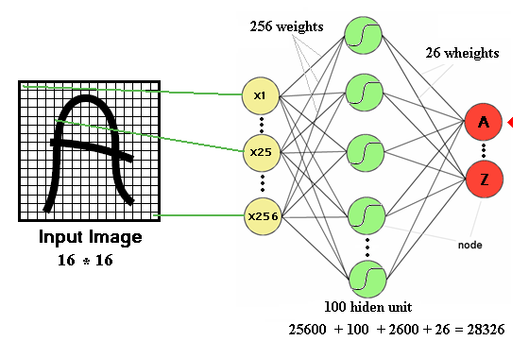
Drawbacks of DNN 常规深度神经网络(DNN)的缺点
Number of trainable parameters becomes extremely large
需要训练的参数极多

Slide 4
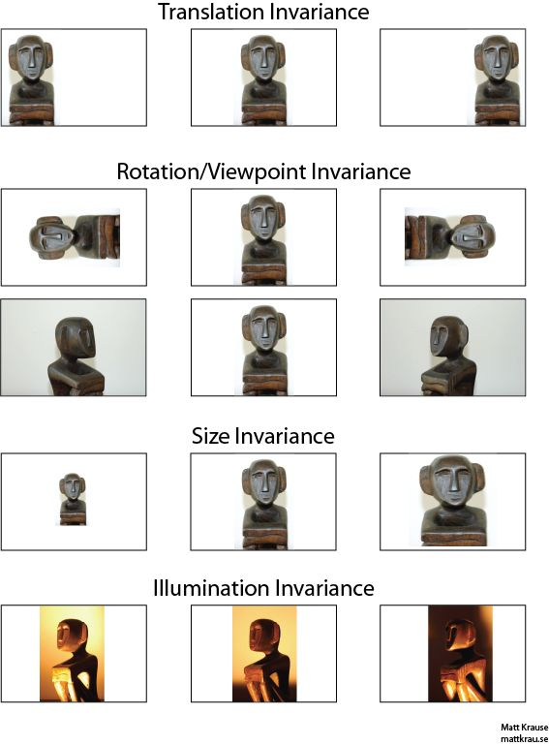
Drawbacks of DNN
Little or no invariance to shifting, scaling, and other forms of distortion
图片的可变性，即图片经过缩放，平移等变形操作，会对结果有严重的影响。

Slide 5
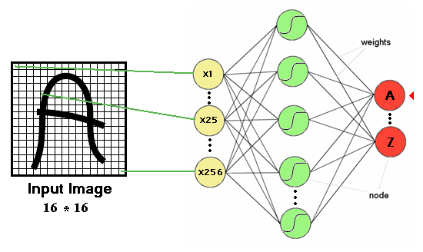
Drawbacks of DNN
Topology of the input data is completely ignored
图片的拓扑性会被完全忽略
Feature 1
Feature 2

Slide 6
Convolutional Neural Network (CNN) 卷积神经网络
Convolutional Neural Networks are inspired by mammalian visual cortex.
卷积神经网络是受到哺乳动物视觉皮层的启发
In 1995, Yann LeCun and Yoshua Bengio introduced the concept of convolutional neural networks.
Visual cortex contains a complex arrangement of cells, which are sensitive to small sub-regions of the visual field, called a receptive field. 视觉皮层包含着一系列组合在一起的细胞，他们是小而敏感的视觉区域，称之为感受野
These cells act as local filters over the input space and are well-suited to exploit the strong spatially local correlation present in natural images. 这些细胞在输入空间上充当局部过滤器，非常适合利用自然图像中存在的强空间局部相关性

Slide 7
Resolution to Convolution

Slide 8
Convolutional Neural Network (CNN)
Two basic cell types:
Simple cells respond maximally to specific edge-like patterns within their receptive field.
简单细胞对它们的感受野内的特定边缘样模式有最大的反应。
Complex cells have larger receptive fields and are locally invariant to the exact position of the pattern. 复杂的细胞具有较大的感受野，并且对于模式的确切位置局部不变。

Slide 9
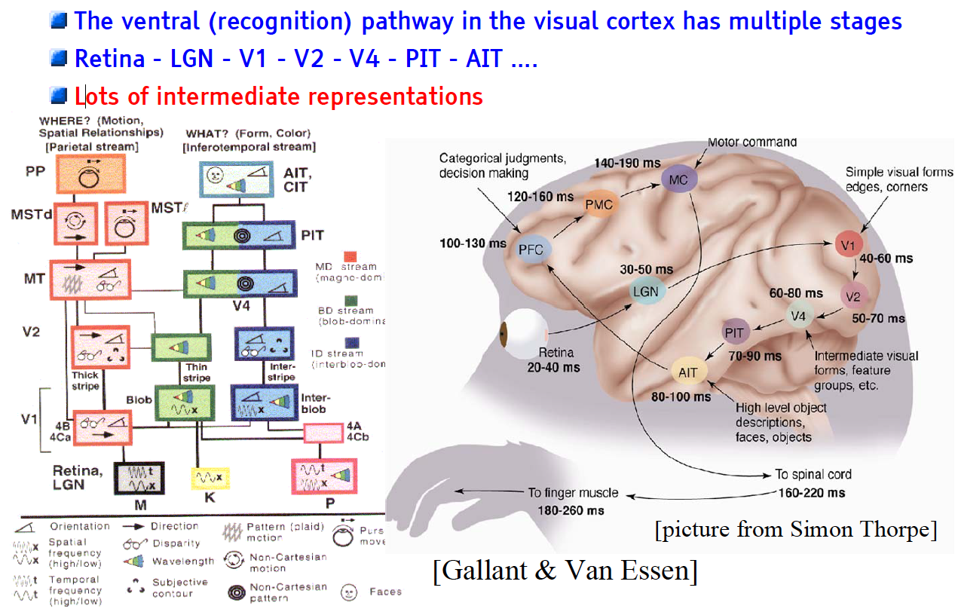
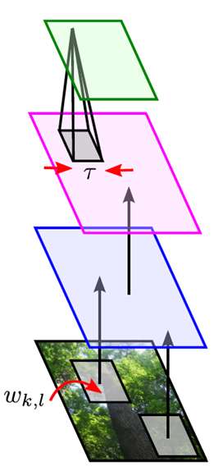
Mammalian Visual Cortex Inspires CNN
Convolutional Neural Net
output
input

Slide 10
Are the horizontal lines straight?

Slide 11
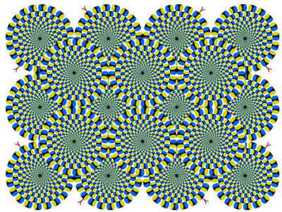
Is it moving?

Slide 12
CNN Architecture
Intuition: Neural network with specialized connectivity structure,
Stacking multiple layers of feature extractors
多层特征提取器的叠加
Low-level layers extract local features.
低级层提取局部特征
High-level layers extract global patterns.
高级层提取全局特征
A CNN is a list of layers that transform the input data into an output class/prediction:
CNN是一个层的集合，它将输入数据转化为类别或者预测的输出
Convolutional layer 卷积层
Non-linear layer 非线性层
Pooling layer 池化层

Slide 13
CNN Architecture
Convolution stage 卷积阶段
Nonlinearity: a nonlinear transform such as ReLU 非线性变化
Pooling: output a summary statistics of local input, such as max pooling and average pooling
池化：输出一个局部输出的统计意义值，例如最大池化/平均池化

Slide 14
Convolutional Networks
Scale up neural networks to process very large images / video sequences
扩大神经网络以处理非常大的图像/视频序列
Sparse connections
稀疏连接
Parameter sharing
参数共享
Automatically generalize across spatial translations of inputs
自动概括输入的空间转换
Applicable to any input that is laid out on a grid (1-D, 2-D, 3-D, …) 适用于网格上的任何输入

Slide 15
Convolutional Layer 卷积层
The core layer of CNNs / CNN的核心层
The convolutional layer consists of a set of filters. 卷积层由一组过滤器组成。
Each filter covers a spatially small portion of the input data. 每个过滤器覆盖输入数据的空间较小部分。
Each filter is convolved across dimensions of input data, producing a multidimensional feature map. 每个过滤器在输入数据的各个维度上卷积，从而生成多维特征图。
As we convolve the filter, we are computing the dot product between the parameters of the filter and the input.
在对滤波器进行卷积时，我们正在计算滤波器参数和输入之间的点积。

Slide 16
Convolutional Layer 卷积层
Intuition: network will learn filters that activate when they see some specific type of feature at some spatial position in input. 直觉：网络将学习过滤器，当他们在输入中的某些空间位置看到某种特定类型的要素时激活。
The key architectural characteristics is local connectivity and shared weights.
关键的体系结构特征是本地连接性和共享权重。

Slide 17
Local Connectivity
Neurons in layer m are only connected to 3 adjacent neurons in the m-1 layer.
Neurons in layer m+1 have a similar connectivity with the layer below.
Each neuron is unresponsive to variations outside of its receptive field with respect to the input.
Receptive field: small neuron collections which process portions of the input data
Ensures the learnt feature extractors produce the strongest response to a spatially local input pattern.

Slide 18
Shared Weights
3 hidden neurons belong to the same feature map
Weights of the same color are constrained to be identical.
Gradient descent can still be used to learn such shared parameters, with a small change to the algorithm.
The gradient of a shared weight is simply the sum of the gradients of the parameters being shared.
Replicating neurons in this way allows for features to be detected regardless of their position in the input.
Weight sharing increases learning efficiency by greatly reducing the number of free parameters being learnt.

Slide 19
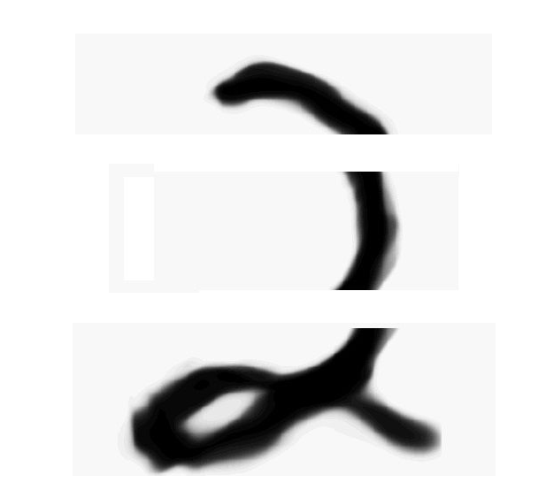
Convolutional Layer 卷积层

Slide 20
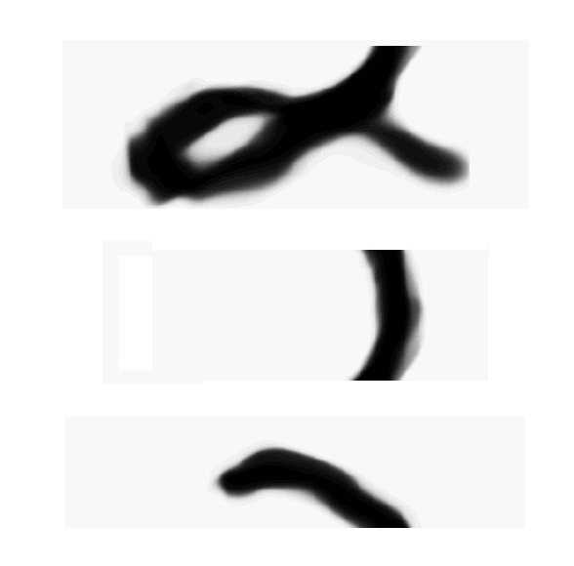
Convolutional Layer 卷积层
如果我们只知道局部的图片，以及局部的相对位置，只要我们能将他们正确组合起来，我们也可以对物体进行识别

Slide 21
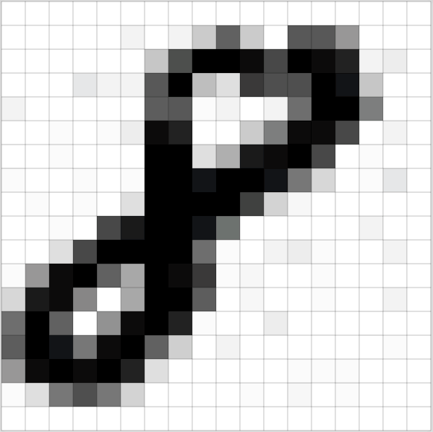
Review for MINST

Slide 22
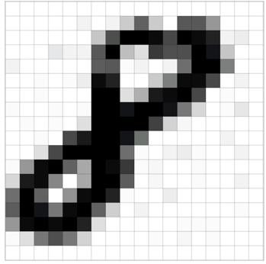
From MNIST
Picture size: 28 *28 pixels
Color channel: 1 (white-grey-black)
Matrix 28*28*1
红色区域
4*4 像素
每次平移1像素
多少次个4*4能覆盖所有像素？
(28-4+1) * (28-4+1)

Slide 23
Camera Filters

Slide 24
Convolution 卷积
Stride 步长
Filter/过滤器/滤波器
卷积核

Slide 25
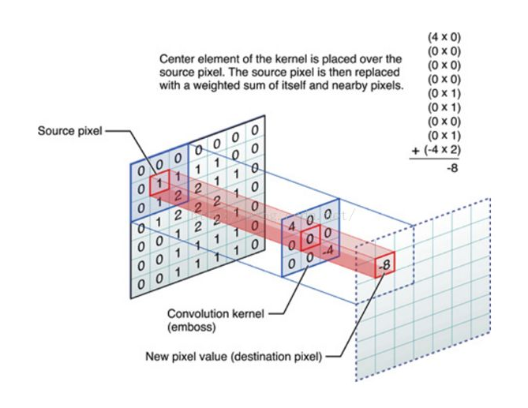
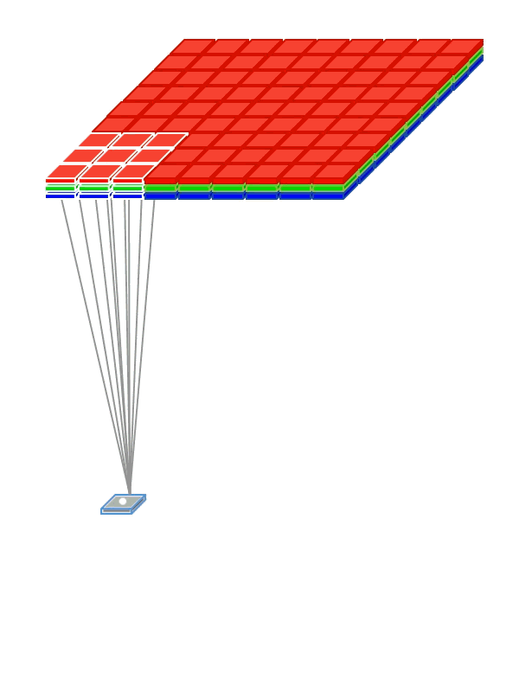
Convolution Example

Slide 26

Convolution Example
输入图像维度？
Kernel/filter/卷积核/过滤器/滤波器大小？
输出维度？
Notes:
输入图像维度？5*5*1
Kernel/filter/卷积核/过滤器/滤波器大小？3*3
输出维度？5-3+1 * 5 -3+1 = 3*3
作者：机器之心 链接：https://www.zhihu.com/question/52668301/answer/131573702 来源：知乎 著作权归作者所有。商业转载请联系作者获得授权，非商业转载请注明出处。 CNN 的第一层通常是卷积层（Convolutional Layer）。首先需要了解卷积层的输入内容是什么。如上所述，输入内容为一个 32 x 32 x 3 的像素值数组。现在，解释卷积层的最佳方法是想象有一束手电筒光正从图像的左上角照过。假设手电筒光可以覆盖 5 x 5 的区域，想象一下手电筒光照过输入图像的所有区域。在机器学习术语中，这束手电筒被叫做过滤器（filter，有时候也被称为神经元（neuron）或核（kernel）），被照过的区域被称为感受野（receptive field）。过滤器同样也是一个数组（其中的数字被称作权重或参数）。重点在于过滤器的深度必须与输入内容的深度相同（这样才能确保可以进行数学运算），因此过滤器大小为 5 x 5 x 3。现在，以过滤器所处在的第一个位置为例，即图像的左上角。当筛选值在图像上滑动（卷积运算）时，过滤器中的值会与图像中的原始像素值相乘（又称为计算点积）。这些乘积被加在一起（从数学上来说，一共会有 75 个乘积）。现在你得到了一个数字。切记，该数字只是表示过滤器位于图片左上角的情况。我们在输入内容上的每一位置重复该过程。（下一步将是将过滤器右移 1 单元，接着再右移 1 单元，以此类推。）输入内容上的每一特定位置都会产生一个数字。过滤器滑过所有位置后将得到一个 28 x 28 x 1 的数组，我们称之为激活映射（activation map）或特征映射（feature map）。之所以得到一个 28 x 28 的数组的原因在于，在一张 32 x 32 的输入图像上，5 x 5 的过滤器能够覆盖到 784 个不同的位置。这 784 个位置可映射为一个 28 x 28 的数组。

Slide 27
Stride 步长
Picture size: 28 *28 pixels
Color channel: 1 (white-grey-black)
Matrix 28*28*1
红色区域
4*4 像素
每次平移2像素
多少次个4*4能覆盖所有像素？
((28-4)/2+1) * ((28-4)/2+1)

Slide 28
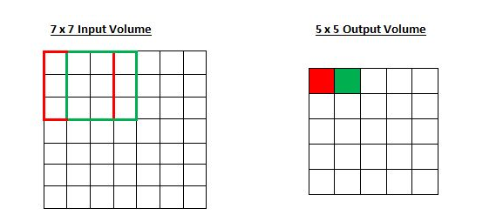
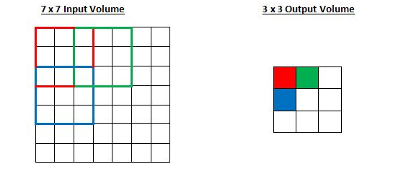
Stride 步长
(Receptive Field)感受野移动了两个单元，输出内容同样也会减小。注意，如果试图把我们的步幅设置成 3，那我们就会难以调节间距并确保感受野与输入图像匹配。正常情况下，如果想让接受域重叠得更少并且想要更小的空间维度（spatial dimensions）时，一般会增加步幅

Slide 29
Zero padding 零填充
5*5的图片会被filter卷积后会变成3*3
每次卷积后都会小一圈的话，
经过若干层后岂不是变的越来越小？

Slide 30
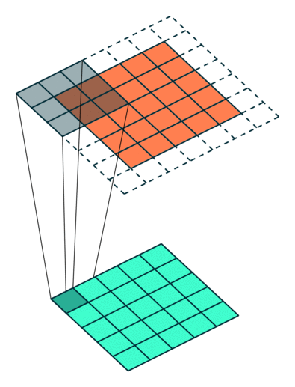
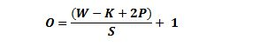
Zero padding 零填充
图像的周围一圈补0
其中 O 是输出尺寸output，
K 是过滤器/卷积核尺寸Kernel size，
P是填充大小padding，
S 是步幅Stride。

Slide 31
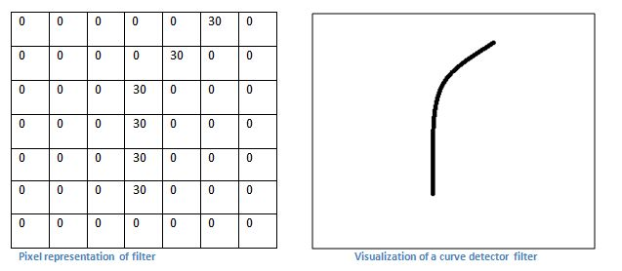

Slide 32
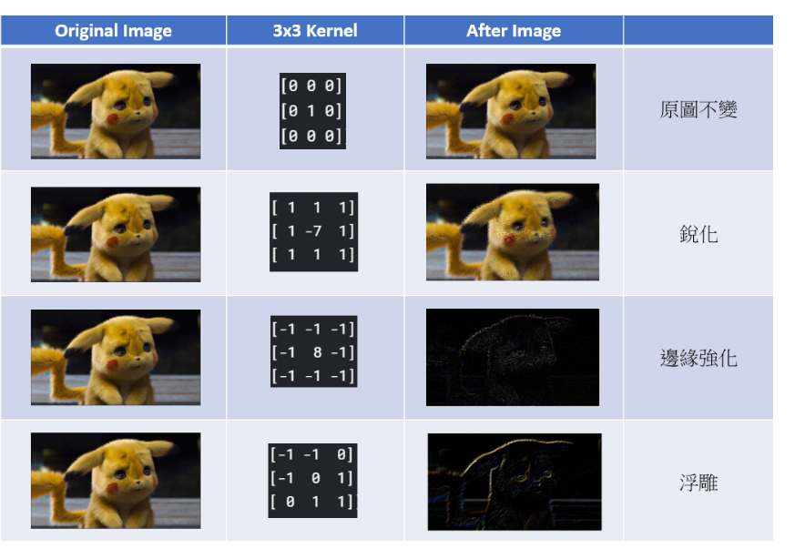

Slide 33

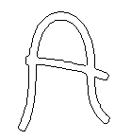
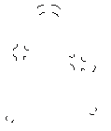
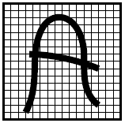
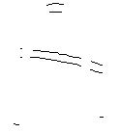
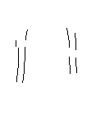

features

Slide 34
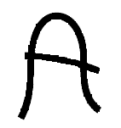
Feature Extraction
-1
0
1
Convolve with
Threshold
-1
0
1
-1
0
1
w11
w12
w13
w11
w12
w13
w21
w22
w23
w21
w22
w23
w31
w32
w33
w31
w32
w33

Slide 35
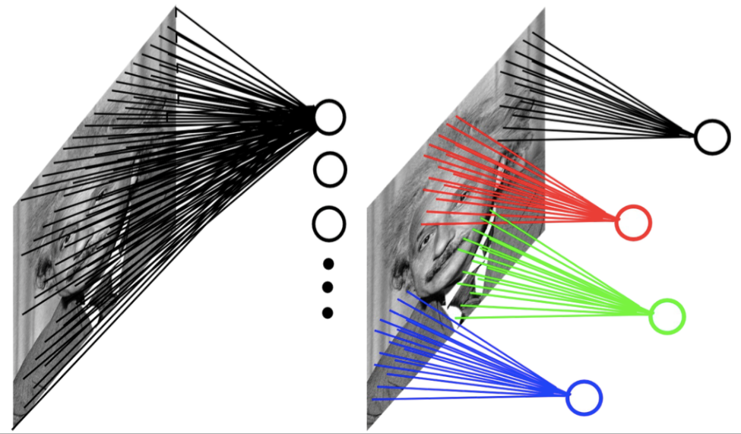
Small Number of Parameters
Input can have very high dimension. Using a fully-connected neural network would need a large amount of parameters. 输入可以具有很高的尺寸。使用完全连接的神经网络将需要大量参数。
CNNs’ hidden units are only connected to local receptive field. The number of parameters needed by CNNs is much smaller. CNN的隐藏单位仅连接到本地接收区域。 CNN所需的参数数量要少得多。
Example: 200x200 image
fully connected: 40,000 hidden units => 1.6 billion parameters
CNN: 5x5 kernel, 100 feature maps => 2,500 parameters

Slide 36
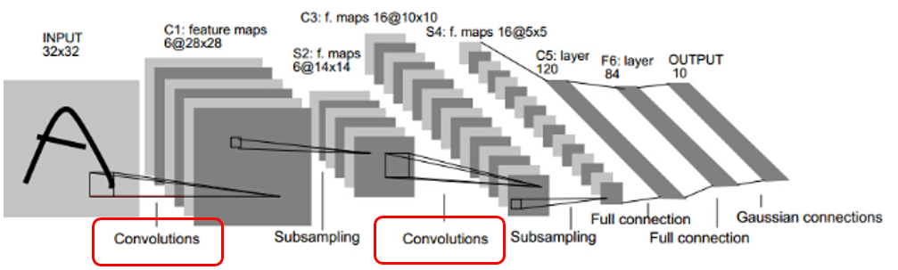
Model Architecture
Input 32*32
6* Kernel size 5*5
Number of feature map = ?
Notes:
6

Slide 37
CNN’s Topology
Feature maps
C
Feature extraction layer
Convolution layer
Shift and distortion invariance or
Subsampling layer
S

Slide 38
Feature Extraction
Detect the same feature at different positions in input image.
features

Slide 39

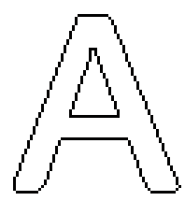
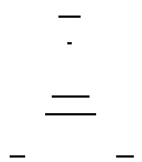
Subsampling Layer 二次采样层
学习发音
二次采样层
Subsampling layers reduce the spatial resolution of each feature map
二次采样层降低了每个特征图的空间分辨率
By reducing the spatial resolution of the feature map, a certain degree of shift and distortion invariance is achieved.通过降低特征图的空间分辨率，可以实现一定程度的移位和变形不变性。

Slide 40
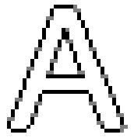
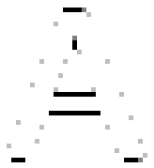

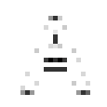

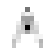
Subsampling Layer 二次采样层
the subsampling layers reduce the spatial resolution of each feature map二次采样层降低了每个特征图的空间分辨率

Slide 41

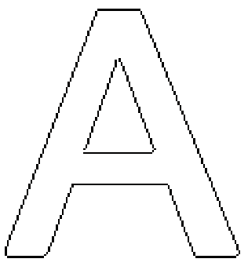
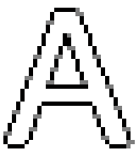




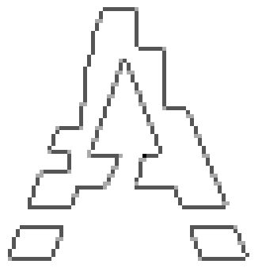
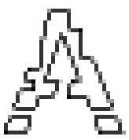
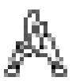
Subsampling Layer 二次采样层

Slide 42
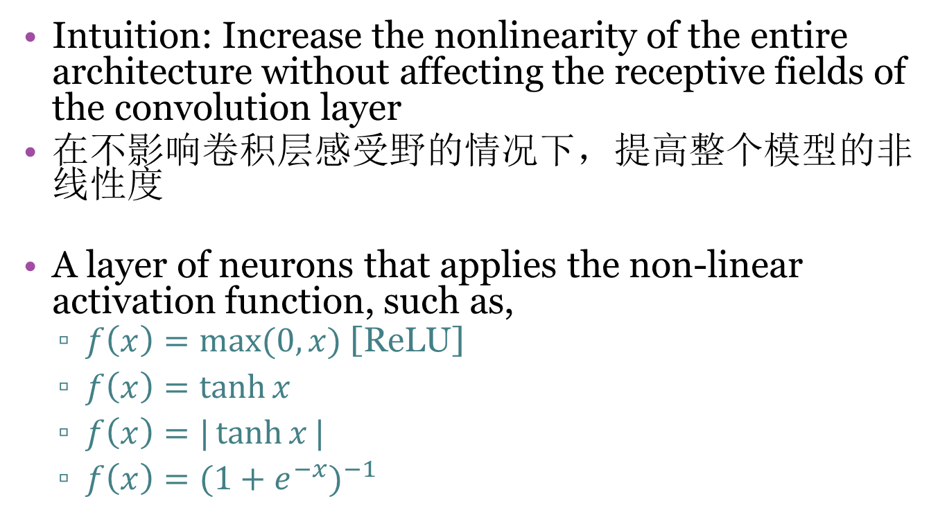
Non-linear Layer
Intuition: Increase the nonlinearity of the entire architecture without affecting the receptive fields of the convolution layer
在不影响卷积层感受野的情况下，提高整个模型的非线性度
A layer of neurons that applies the non-linear activation function, such as,
$f\left(x\right)=\max{(0,x)}$ [ReLU]
$f\left(x\right)=\tanh{x}$
$f\left(x\right)=|\tanh{x}|$
$f\left(x\right)={(1+e^{−x})}^{−1}$

Slide 43


Pooling Layer / Max-Pooling 池化层/最大池化
Intuition: to progressively reduce the spatial size of the representation (amount of parameters) and computation in the network, and hence to also control overfitting
逐步减小表示形式（参数的数量）和网络中计算的空间大小，从而也控制过度拟合
Pooling partitions the input image into a set of non-overlapping rectangles and, for each such sub-region, outputs the maximum value of the features in that region.
池化过程将输入图像划分为一组不重叠的矩形，并且对于每个此类子区域，输出该区域中要素的最大值。
Input

Slide 44
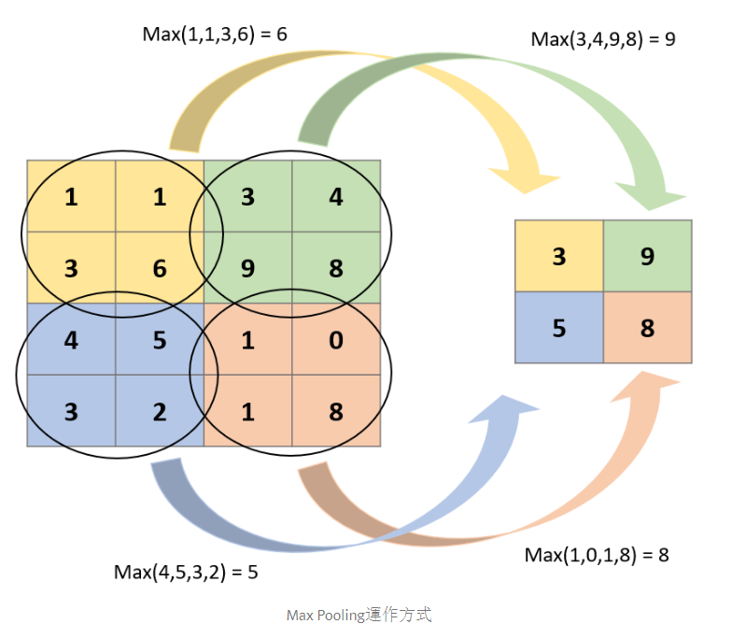
Pooling Layer / Max-Pooling 池化层/最大池化
Kernel size？
步长 Stride？
Kernel size？2*2
步长 Stride？2

Slide 45
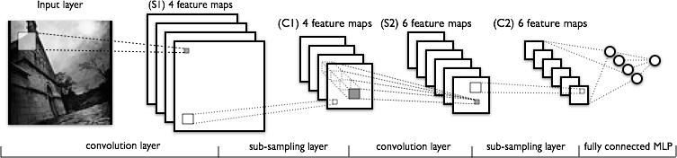
Fully Connected Layer 全连接层
The final high-level reasoning in the neural network is done via fully connected layers. 神经网络中的最终高级推理是通过完全连接的层完成的。
Takes all neurons in the previous layer (pooling or convolutional) and connects it to every single neuron it has. 获取上一层中的所有神经元（池化或卷积），并将其连接到它拥有的每个神经元。
Fully connected layers are not spatially located anymore (you can visualize them as one-dimensional), so there will be no convolutional layers after a fully connected layer.
完全连接的层不再在空间上定位（您可以将它们可视化为一维），因此在完全连接的层之后将没有卷积层。

Slide 46
Fully Connected Layer 全连接层
The final high-level reasoning in the neural network is done via fully connected layers. 神经网络中的最终高级推理是通过完全连接的层完成的。
Takes all neurons in the previous layer (pooling or convolutional) and connects it to every single neuron it has. 获取上一层中的所有神经元（池化或卷积），并将其连接到它拥有的每个神经元。
Fully connected layers are not spatially located anymore (you can visualize them as one-dimensional), so there will be no convolutional layers after a fully connected layer.
完全连接的层不再在空间上定位（您可以将它们可视化为一维），因此在完全连接的层之后将没有卷积层。

Slide 47
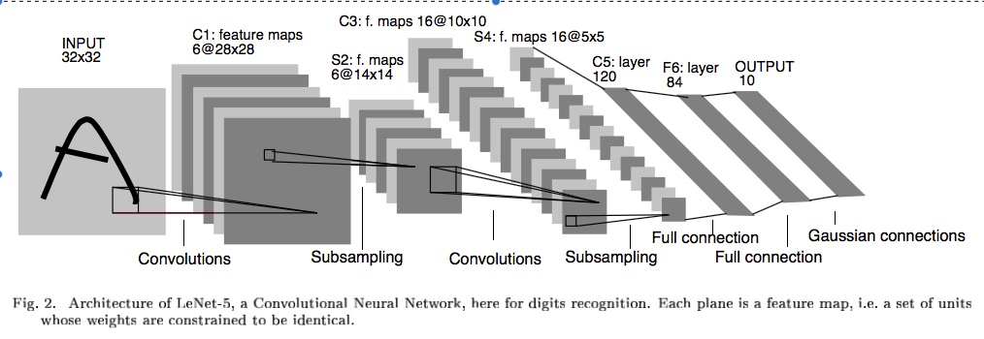
Fully Connected Layer 全连接层

Slide 48
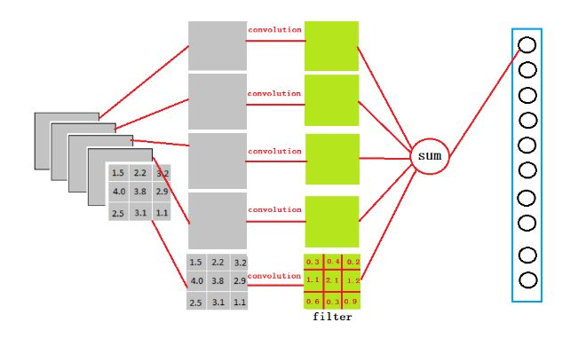
Fully Connected Layer 全连接层
激活函数输出的结果是6个3*3的feature map
用5个3*3的kernel去卷积 获得5个值
5个值求和会有1个值

Slide 49
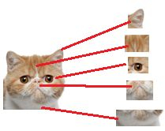
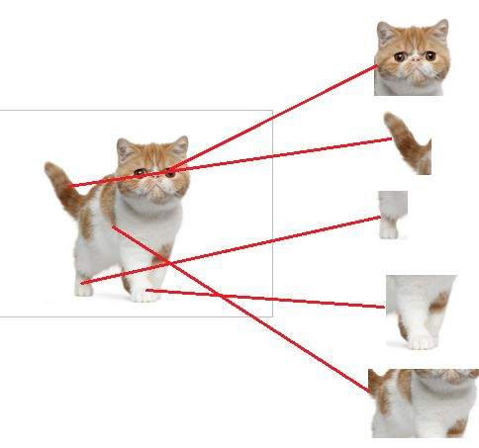
Fully Connected Layer 全连接层
卷积层 通过细节(kernel)
找到猫头(feature map)
Pic source
https://zhuanlan.zhihu.com/p/33841176
全连接层把所有找到的最优feature map
连起来 综合推断

Slide 50
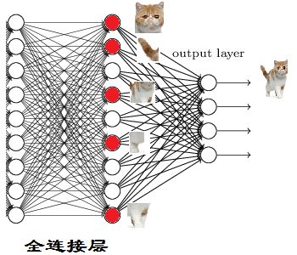
Fully Connected Layer 全连接层
Pic source
https://zhuanlan.zhihu.com/p/33841176

Slide 51
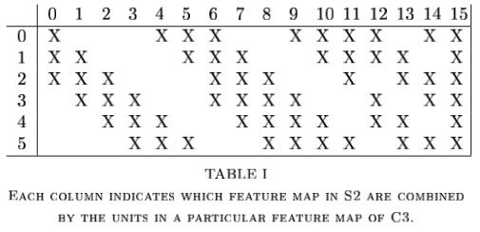
Example – LeNet-5
To help it all sink in:
How many weights to be trained at each layer?
5x5 2x2 5x5 2x2 Fully Connected
Notes:
Why 32x32 to start with. Actual characters never bigger than 28x28. Just padding the edges so for example the top corner node of the feature map can have a pad of two up and left for its feature map.
Same drop occurs with 14x14 to 10x10 drop S2 to C3
C1: 156 weights (26*6), 122,304 connections 26*28*28*6 – Parameter sharing - regularization
S2: 12 weights (6*2). 5 (4 connections plus bias)*6*14*14 = 5880 connections, sampling is adding – the 4 inputs are added, then multiplied by weight, then add bias, then squash, non over-lapping
C3: 6 connect to 3, 9 to 4, and 1 to all 6, forces discovery of more diverse feature combinations
Table 1 only considers contiguous subsets of 3, and more mixed subsets of 4 feature maps, and one with all – heuristic explanation
6*(25*3+1) + 9*(25*4+1) + 1*(25*6+1) =1516 total weights, total connections are 10*10 more than that for 151,600
S4: 16*2 = 32 weights, 16*5*5*5(4 connections plus bias) = 2000 connections
C5: 120*(5*5*16+1) = 48,120 weights and connections are the same since it is just a fully connected MLP at this point
F6: 84*(120+1) = 10,164
Output: 10*(84+1) = 850
He used a special RBF output approach in his LeCun-5 model. Could commonly have just gone into an output layer at F6 with 10 output nodes. Then would have been 10*(120+1) = 1210 weights going to the last output layer
Total: 340,908 connections, but 60,000 trainable parameters

Slide 52
CNN Properties CNN的属性
High accuracy for image applications – Breaking all records using just raw pixel features!图像应用的高精度–仅使用原始像素功能即可打破所有记录！
Suitable for problems with strong grid-like local spatial/temporal correlation适用于具有类似网格的局部时空相关性强的问题
Once trained on one problem (e.g. vision) could use same net (often tuned) for a new similar problem – general creator of vision features
Notes:
Dynamic size – Pooling region just sums/maxes over an area with one final weight so no hard changes when we adjust pool region size
Simard 2003, Simple consistent CNN structure 5x5 with 2x2 subsampling with number of features 5 in first C-layer, 50 in next, until too small.
Don’t actually used pool layer as instead just connect every other node which samples rather than max/average.
Each layer reduces feature size by (n-3)/2. Just two layers for mnist.
They also use elastic distortions which is a type of jitter to get increased data. 99.6% - best at the time, Distortions also help a lot with standard MLP
Thus an approach with less Hyperparameter fiddling
Ciresan and Schmidhuber 2012, Multi column DNN. CNN with depth 6-10 (deeper if initial input image is bigger), and wider on fields, 1-2 hidden layers in MLP, columns are CNNs (an ensemble with different parameters, features, etc.) where their output is averaged, jitter inputs, multi-day GPU training, annealed LR (.001 dropping to .00003) 99.76% mnist

Slide 53
CNN Properties CNN的属性
Unlike traditional nets, handles variable sized inputs与传统的网络不同，处理可变大小的输入
Same filters and weights, across different sized image and dynamically scale size of pooling regions, to normalize different sized images, length speech segments, etc.
利用同样的filters和weights，利用动态池化处理不同大小的输入图像，来标准化不同的输入图像
Lots of hand crafting and tuning to find the right recipe of receptive fields, layer interconnections, etc.
有许多可以手动调节的参数 例如感受野，层联系
Notes:
Dynamic size – Pooling region just sums/maxes over an area with one final weight so no hard changes when we adjust pool region size
Simard 2003, Simple consistent CNN structure 5x5 with 2x2 subsampling with number of features 5 in first C-layer, 50 in next, until too small.
Don’t actually used pool layer as instead just connect every other node which samples rather than max/average.
Each layer reduces feature size by (n-3)/2. Just two layers for mnist.
They also use elastic distortions which is a type of jitter to get increased data. 99.6% - best at the time, Distortions also help a lot with standard MLP
Thus an approach with less Hyperparameter fiddling
Ciresan and Schmidhuber 2012, Multi column DNN. CNN with depth 6-10 (deeper if initial input image is bigger), and wider on fields, 1-2 hidden layers in MLP, columns are CNNs (an ensemble with different parameters, features, etc.) where their output is averaged, jitter inputs, multi-day GPU training, annealed LR (.001 dropping to .00003) 99.76% mnist

Slide 54
CNN Advantages
Architecture of a CNN is designed to take advantage of the 2D structure of an input image
CNN的架构旨在利用输入图像的2D结构
Achieved with local connections and tied weights followed by some form of pooling which results in translation invariant features.
通过本地连接和权重绑定以及随后的某种形式的池化来实现特征的不变性 ——鲁棒性
CNN are easier to train and have many fewer parameters than fully connected networks with the same number of hidden units. CNN更容易训练，因为他在同样隐层数量下，与全连接神经网络有更少的参数
Demo of CNN: http://scs.ryerson.ca/~aharley/vis/conv/

Slide 55
Summary
CNN for strong grid-like data with local correlation
Convolution operation
Subsampling
Feature extraction
Shared weights
Pooling
Full connection

Slide 56
Further Reading
https://papers.nips.cc/paper/4824-imagenet-classification-with-deep-convolutional-neural-networks.pdf
https://arxiv.org/pdf/1311.2901v3.pdf
https://arxiv.org/pdf/1409.1556v6.pdf
http://www.cv-foundation.org/openaccess/content_cvpr_2015/papers/Szegedy_Going_Deeper_With_2015_CVPR_paper.pdf
https://arxiv.org/pdf/1512.03385v1.pdf
https://arxiv.org/pdf/1506.02025.pdf
Inception-v4, Inception-ResNet and the Impact of Residual Connections on Learning. https://arxiv.org/abs/1602.07261v2.
.., Rethinking the Inception Architecture for Computer Vision. https://arxiv.org/abs/1512.00567v3.
.., Wide-Residual-Inception Networks for Real-time Object Detection. https://arxiv.org/pdf/1702.01243v1.pdf

Slide 57
Acknowledgments
This file is for the educational purpose only. Some materials (including pictures and text) were taken from the Internet at the public domain.

